Slide 1
CMPSC 100
Computational Expression

Slide 2
Goal for today: write and run some Java
Today, you’ll do the following:
Install java locally so that you can experiment with coding on your own
Write the “Hello, World” program in Java and observe how running and “compiling” it behaves
Develop and take note of your questions, as we’re going to cover what happens today when we reconvene on Monday.
Also on Monday: some #realtalk about software difficulties and the rest of the semester
But, before we get too far into the practical, there’s one rule:

Slide 3
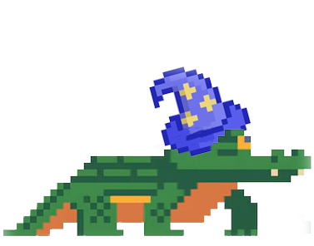
THE CODE MUST BUILD

